Slide 1
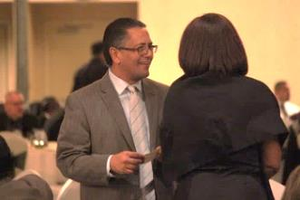
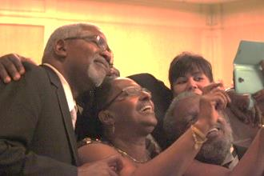
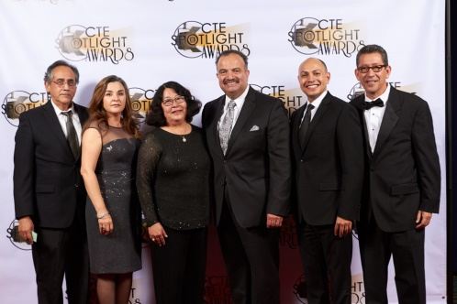
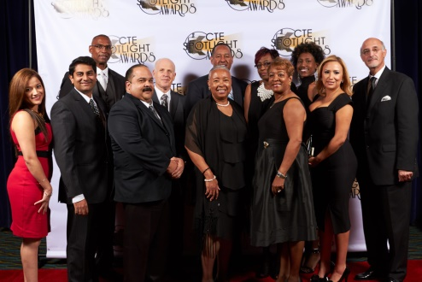
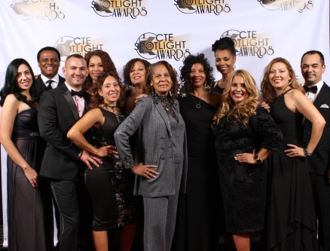
CTE Spotlight Awards Ceremony
NACCE 2016 Masterminds Academy

Slide 2
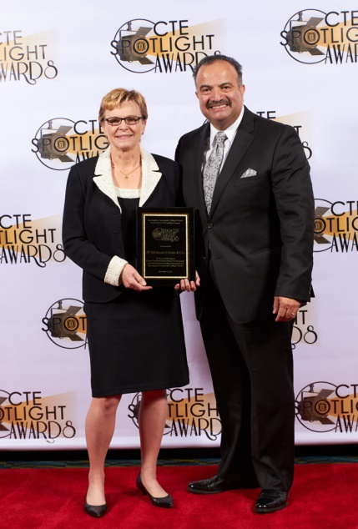
CTE Spotlight Awards Vision
To become the premier signature CTE awards ceremony that recognizes advocacy and excellence in CTE locally, regionally, statewide, and nationwide.
CTE Spotlight Awards Mission
To celebrate student, faculty, and industry contribution, advocacy, and excellence to/in CTE programs in community colleges across and outside of the State of California.

Slide 3
CTE Spotlight Awards Committee
Stakeholders assemble to plan and execute awards ceremony.
Handles all aspects of planning and executing ceremony.
Roles are designated and timelines are defined.
CTE Spotlight Awards Calls For Nominations
Nominations forms are generated for each community college via Survey Monkey.
Community Colleges are provided nomination forms with scoring rubric information.
Community Colleges are responsible for dissemination information to get nominations for each recipient category.
Community Colleges are responsible for submitting one honoree per category

Slide 4
CTE Spotlight Awards Recipient Categories
[2016] CTE Spotlight Award (one industry partner with greatest impact on CTE - plague)
Board of Trustees CTE Advocacy Awards (industry plagues)
President’s CTE Excellence Awards (faculty plagues)
Faculty CTE Honors Awards (students plagues and $150 scholarship)
CTE Spotlight Awards Fundraising
CTE Advertisement for the promotion of CTE programs in Souvenir Journal Program
Corporate Sponsorships
Facilitated through Community College Foundation

Slide 5
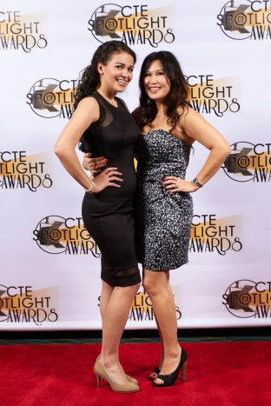
CTE Spotlight Awards Ceremony
VIP Reception
Board Members, Chancellor, Presidents say a few remarks to sponsors and honorees
Awards Ceremony
Seated Meal – No Host Bar
Co-Hosted by CTE Dean and Senior Leader
Step N Repeat for photos opportunities
Souvenir Journal
CTE Spotlight Awards Ceremony
Awards Ceremony (Cont’d)
30 second videos are cued once honorees are announced
Honorees are invited to stage with respective presenter (trustee for industry; president for faculty; faculty for student)

Slide 7
NACCE Masterminds Academy for LA Region Community College Students
Mission
Prepare students for key roles of project implementation at the 2016 NACCE Conference that enhances there areas of study
Sponsors
DSN Small Business
NACCE
Corporations
NACCE Masterminds Academy
Student Information
Receive Soft Skills Training through New World of Work program
Receive Etiquette and Customer Service training
Assigned Conference Production Tasks
Receive “Dress for Success” coaching session
Receive Scholarship for Professional Conference Attire

Slide 8
NACCE Masterminds Academy
Travel Information
Paid transportation to and from conference
Paid hotel accommodation
Paid conference registration
Paid conference meals
Student Eligibility
Submit 30 second video via YouTube or Vimeo upload oh how conference will benefit educational and career aspirations.
NACCE Masterminds Academy
Student Eligibility
Enrolled full or part-time with good academic standing.
Submit photo/bio not to exceed 2500 characters w/details about education and career path.
Identify category in which to participate at conference.
Application Deadline
Friday, June 17 (may need to be extended)

Slide 9
NACCE Masterminds Academy
NACCE Project Categories
Business Technology
Communications
Project Management
Sales and Customer Service
Theatre, Entertainment, and/or Stage Design
Value to Students
Receive complimentary NACCE Conference Registration
Receive Cooperative Education Work Experience college credit
NACCE Masterminds Academy
Value to Students (cont’d)
Career development coaching for to secure and retain job or career
Funding for travel, lodging and food while at conference
Receive scholarship for professional suit for conference and/or future interviews
Recognition at the conference
Opportunity to work alongside leadership

